Slide 1

git
a stupid content tracker
Notes:
[2-3 min] Brief introduction to who you / I are/am

Slide 2
Why Revisions?
Oops ! moments
Wasn’t last one better ? Where the F is it ?
Backup
Notes:
Ask them what could be the most basic revision control they could think of.
And if they answer, question them why and what level of change do they manage.
Ask them why do we need to maintain revisions? What problems do they solve?

Slide 3
The Problems
Can’t Predict where to stop.
Short-lived.
What if we messed up a feature?
I lost my CTRL key while undoing a day’s work
Notes:
and explain them what problems they don’t address.
Difficult to predict which actually is the safe state of the code.
Closed ur editor or got a Blue Screen of Death?
And how do I handle undoing changes spanned across files?

Slide 4
IDEs are Cool
Saves Local Histories on a file basis.
Maintains Histories up to days.
Allows us to compare diffs.
Allows to change editors content from older version.
Allows you to label a specific state.
Notes:
Open up an ide and give them an overview of local history in a sample project. Explain how can you make use of all the above stuffs

Slide 5
The Problems
Can’t Predict where to stop [Using labels]
Short-lived [May be]
What if we messed up a feature?
What about collaboration ?
Notes:
Once again explain them the problems they don’t solve.

Slide 6

Copy / Snapshots?
Some Fun
Notes:
When you say copy paste snapshots, all problems like
How do we know which snapshot belongs to what feature?
How do we know if some snapshot was made live?
How do we diff between two different states?
To solve all this problems we might have to hire a code librarian ;)

Slide 7
Few More..
Maintaining meaningful states.
Track Changes across such meaningful states.
Need for Branching.
Notes:
When we say revisions, in a project of which is worked on a large scale revisions should mean some meaningful states not just a random version
And keeping just the revisions is not worth an effort.. The best part is how efficiently can we make use of them. One such example is tracking the changes between revisions and tracking the contributions of developers across the team.
A project can grow deeper [development effort in single feature] or broader [More features]. Branching makes it easier to experiment or sandbox whatever a developer wanna try out in his own pace without disturbing the mainstream development.

Slide 8
To Summarize
Maintain Meaningful States
Track Changes
Undo
Sandboxing
Branching and merging
Notes:
most probably we might reach here by first 30-45 min based on the discussion levels.
Assume versions of any software that’s released
What changes for every release cycle?
Revert a change once things break after release or testing?
Test a feature only on a targeted audience or ab test
Give developers some wings [What we have seen in the past is, people start shivering when they are asked to make changes in live code]

Slide 9
git
“In many ways you can just see git as a filesystem — it’s content-addressable, and it has a notion of versioning, but I really really designed it coming at the problem from the viewpoint of a filesystem person (hey, kernels is what I do), and I actually have absolutely zero interest in creating a traditional SCM system.” – Linus
GIT as a Version Control System is an use case
Non-SCM Use Cases of GIT:
Peer to Peer Content Distribution Network
Distributed Document Oriented Database [like wiki]
Notes:
Brief history
Kernel was developed and maintained on Bitkeeper from ~1991 to 2002
2002, relationship broke, and Mr. Torvalds took up the problem in his hands

Slide 10
What’s in store ?
90 % of what is used, which is probably just 5% of what git’s features
Git Structure
Committing and viewing history
Remotes / Syncing with server
Branching & Merging
Forking, Branching, Pull Requests
Complex Undo[s]
Other common git tools / commands
Notes:
for may be out of 4 sessions 3 would cover 90% of git and remaining 10% is left out for exploration

Slide 11
Let’s Hack Around
1. Installation
2. Vocabulary
3. Let’s do git
Notes:
Start hacking around. Windows ppl might need some help

Slide 12
Configure GIT
$ git config --global user.name "<firstname>.<lastname>" $ git config --global user.email <firstname>.<lastname>@media.net”
$ git config --global alias.ci commit
$ vim ~/.gitconfig
# Here is my .gitconfig
$ git config --list
Notes:
Can show ~/.gitconfig
[alias]
ci = commit
st = status
di = diff
co = checkout
k = !gitk --all
g = log --graph --pretty=format:'%Cred%h%Creset -%C(yellow)%d%Creset %s %Cgreen(%cd) %C(blue)<%cN>%Creset' --abbrev-commit --all
; g = log --graph --pretty=format:'%Cred%h%Creset -%C(yellow)%d%Creset %s %Cgreen(%cr) %C(blue)<%cN>%Creset' --abbrev-commit --date=relative --all
d = difftool
[color]
ui = true
[user]
name = Ruturaj K. Vartak
email = ruturaj.v@directi.com
[diff]
tool = meld
[push]
default = simple

Slide 13
SSH Keys
Ensure u’r keys are generated
$ls -l ~/.ssh/id*
$ ssh-keygen
We’ll come to it in a moment ...

Slide 14
GIT Help
git-help - Display help information about Git
$ git help init
$ git help add
$ git add -h // Short help
$ git add --help // same as “git help add”

Slide 15
Vocabulary
1. Commit - Reference to a Meaningful State
2. Repository : Collection of commits
3. Working Tree : Any directory which has repository associated
4. Index/Staging area : Git doesn't commit changes directly from working tree to repo
5. Status - State of your current working directory
6. Stage - incrementally "add" changes to the index before the commit
7. Branch - a snapshot of commit which can be independently worked on
8. Merge - process of connecting to meaningful states into one
9. Remote - Remote directory which makes collaboration easier
10. Blob - A File in GIT FS
11. Tree - The way GIT Maps its files in GIT FS
12. HEAD - A Cheap Pointer which always returns previous saved state of a branch
13. Tag - A Cheap pointer to any saved state
For More: git help glossary
Notes:
Just state these as vocabs as git

Slide 16
GIT Data Model
HEAD
branch
remote
commit
tag
tree
blob
Notes:
Explain a bit of how git stores its data. Don’t deep dive into it.. Just very brief one

Slide 17
Let’s do git
Creating a local repo
Adding Files [Why we need a stage?]
Removing and Moving Files
Viewing Status
Viewing the diff
Committing files
Viewing Logs
Undo
Branching and Merging [Rebase]
Conflict Resolution
Notes:
Hands on from now on

Slide 18
Create a local repo
git-init - Create an empty Git repository or reinitialize an existing one
$ mkdir training
$ cd training
$ git init
Initialized empty Git repository in /home/user/training/.git/
Notes:
show them the contents of .git repository [may not be in detail]. Mention that is the object data base of GIT.

Slide 19
Viewing the status
git-status - Show the working tree/directory status
$ git status
# On branch master # # Initial commit # nothing to commit (create/copy files and use "git add" to track)
Notes:
Explain them that in most of the cases git commands itself will teach you what you may do next.

Slide 20
Add a file
$ cat > README This is my first git project
$ git status
$ git add README
$ git status
$ cat >> README
Make a note of it
$ git status
$ git add README
$ git status
Notes:
Make Sure:
We see status
1. Once we create a file
2. Once we add the file for tracking
3. Once after editing
Stress the point of incrementally "add" changes to the index before the commit

Slide 21
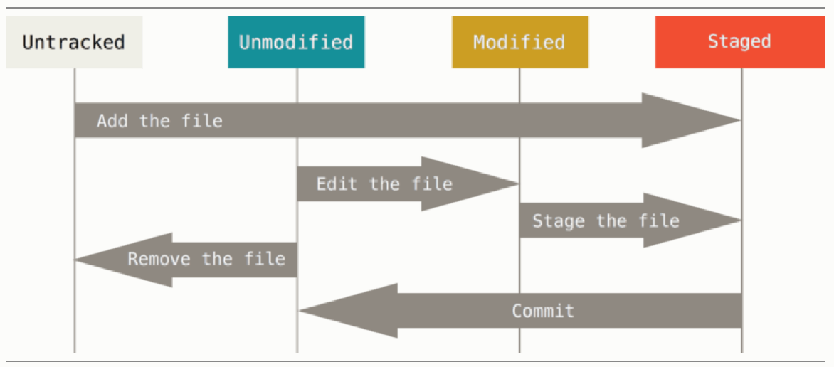
Tracking
Notes:
Explain them the different states of GIT in correlation with what we just saw
Tracked files are files that were in the last snapshot; they can be unmodified, modified, or staged. Untracked files are everything else –
When you first clone a repository, all of your files will be tracked and unmodified because Git just checked them out and you haven’t edited anything.

Slide 22
Viewing the diff
git-diff - Show changes between commits, commit and working tree, etc
$ cat >> README
test it
$ git status
$ git diff
diff --git a/README b/README index 68970cf..3c37412 100644 --- a/README +++ b/README @@ -1,2 +1,3 @@ This is my first git project make a note of it +test it

Slide 23
Remove or Move Files
git-rm - Remove files from the working tree and from the index
git-mv - Move or rename a file, a directory, or a symlink
$ git rm test
$ git rm --cached test
$ git rm -rf dir
$ git mv test newtest
Notes:
You can remove files from both file system and git
You can choose to untrack files but not to remove filesystem
You can also move around files and directories

Slide 24
Commit
git-commit - Record changes to the repository
$ git commit -m “Hurray! my first commit”
[master (root-commit) c2e1009] Hurray my first commit 1 file changed, 6 insertions(+) create mode 100644 README $ git commit -am “A Commit without staging”
$ git commit --amend
Notes:
This is the first step where we see that your change is recorded. So, basically in git a revision means a commit. Till then whatever change u continue making are considered local and are just indexed. And git system doesn’t record them.
Explain why do we need add instead of directly commit
[Add makes sure we move only intended changes to the repository].
But in most of the cases, end up skipping index/stage. Shouldn’t be done !!!

Slide 25
Viewing the diff [revisited]
$ git diff HEAD
$ git diff 9fbe57
$ git diff --staged
$ git diff --staged 9fbe57
Notes:
Explain what else diff could be used for

Slide 26
Viewing the Logs
$ git log
$ git log --author=ronaldo
$ git log --since=’yesterday’
$ git log --grep='Hurray'
Notes:
Logs are assets for larger teams + code bases.
Searching through them in the respect of user, time or features is very much needed.
You can never commit without a proper commit message [unlike other version control systems].
We’ll see much better use cases of having proper commit messages towards the end of the ppt.
https://git-scm.com/docs/git-log

Slide 27
GIT Treeish
$ git show HEAD
$ git show HEAD~1
$ git show HEAD^^
$ git show HEAD@{2}
$ git show HEAD@{yesterday}
$ git show HEAD^1
Ref: https://git-scm.com/docs/git-rev-parse
Notes:
~ = 1’st Parent’s n’th generation
^ = n’th parent , just ^ = ^1
^2 = 2nd parent
@n =specifies the n-th prior value of that ref.

Slide 28
Undo [data]
git-checkout - Checkout a branch or paths to the working tree
$ git checkout -- filename
$ git checkout -- .
Note: checkout can’t come for rescue if the file changes are staged to commit
Notes:
One of the very important feature of any source control management is it’s ability to revert stuffs back and bring the things to normal.
Developers are always expected to mess up stuffs.
Reverting can be done at different levels in git
1. Working Directory Level
2. Unstaging Changes
3. Complete Resetting
4. At a commit level
Checkout helps us reverting all our messed up states or specific paths in working tree provided the changes weren’t staged.

Slide 29
Undo [data]
git-revert - Revert some existing commits
$ git revert HEAD^1
Note: Reverting commits would result in conflicts.
Notes:
If you feel one specific commit in the repository introduced a bug? Then revert is your saviour.
Create a new file instead of editing the same file.. To make sure u don’t have to deal with conflicts there on
“Thumb rule of GIT - Try to fix it rather revert” - But rules are meant to be broken

Slide 30
Undo [history]
git-reset - Reset current HEAD to the specified state
$ git reset HEAD README
$ git reset --hard(soft|mixed|merge|keep) commit
Note: Can unstage changes from index or reset HEAD to specified commit
Notes:
Reset comes in handy when our changes are staged and we wish to revert them back.
Explain how staged changes of a file can be reverted completely
Explain all three available options of reset with a use case.
Soft - Does not touch the index file or the working tree at all
Mixed (default) - Resets the index but not the working tree
Hard - Resets the index and working tree
Merge - Resets the index and updates the files in the working tree that are different between <commit> and HEAD, but keeps those which are different between the index and working tree (i.e. which have changes which have not been added).

Slide 31
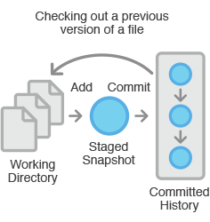
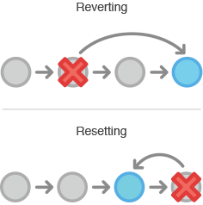
Undo (Checkout vs Reset vs Revert)

Slide 32
Ignore Files
Ignores Files from
1. .gitignore from directories [like IDE Related Folders]
2. $GIT_DIR/info/exclude [Project Specific Setting like logs, binaries]
3. core.excludesfile [Stuffs needn’t be shared among developers]
Note: GIT by default ignores empty directories
Notes:
Give them scenarios for ignoring directories or files in large code bases.
Like show them projects with .idea folders, node_modules

Slide 33
Ignore Files
1. Empty Lines and Comments (#)
2. Ignoring directories
3. Relative Paths from location of .gitignore files
4. Wildcards **/, /**, **/a/**
5. Negate !
6. *.o
Notes:
Ask them to try some sample ignore statements.
Like omitting all but one file in a directory
Omitting most commonly occurring directories throughout the project
Wildcard patterns

Slide 34
Branching
Creating a branch is nothing more than just writing 40 characters to a file.
$ git checkout -b test
$ git checkout master
$ git branch
$ git branch -a
$ git branch -d test
Note: Branching feels awesome when we get to understand how it is done in git.

Slide 35
Pause..
Notes:
Ask ppl to create a new branch and start editing some contents

Slide 36
Merging
git-merge - Join two or more development histories together
$ git checkout master
$ git merge test
Note: Merge points needn’t be branches always . It can be any two commits even.

Slide 37
Merging
Types:
Fast Forward [--no-ff]
3-Way Merge
Strategies:
Resolve
Recursive [Default for merging 2 branches]
Ours
Octopus [Default for merging from more than one branch]
Subtree

Slide 38
Merging [Fast Forward]
After Merge:
HEAD
C0
C1
C3
Test
--no-ff Mode:
HEAD
HEAD
C0
C1
C3
C0
C1
C4
C3
Test
Test

Slide 39
Merging [3-Way]
HEAD
HEAD
Base
Ours
C0
C1
C3
C0
C1
C3
C5
C4
C4
Test
Test
Theirs

Slide 40
Merge (squash)
Used when merger (project owner) wants a cleaner way to merge, doesn’t like parallel runways
Devs can keep “their’’ history, project doesn’t need it
$ git checkout master
$ git merge --squash bugfix
Notes:
Show ~/code/git-squash (http://tree.mn/gittutorial/merge)
$ git co master
$ git merge --squash feature

Slide 41

Merge Conflicts
Notes:
Git clone https://github.com/ruturajv-media-net/merge-conflict.git
Cd master
Cd merge crazybranch ## Generates an error
Ask them to set merge.tool = vimdiff (check your ~/.gitconfig)
Explain base, local and remote - resolve

Slide 42
Undo Revisited
Undo a FF merge
$ git reset --hard <commit before merge>
$ git reset --hard @{1}
Undo a 3 Way merge
$ git revert -m <merge-commit-hash>

Slide 43
GIT Rebase
Later Checkout Master and do a fast forward merge
HEAD
HEAD
Base
Ours
C0
C1
C3
C0
C1
C3
C4’
C4
Test
Test
Notes:
Claims to keep ur history clean.
Will go completely wrong if u rebase a branch which is already pushed to remote.
Always consider rebasing on a feature branch rather on master branch. Reason being conflicts can be resolved at own ease without messing up the master.

Slide 44
GIT Rebase
git-rebase - Forward-port local commits to the updated upstream head
$ git checkout test
$ git rebase master
$ git rebase master test
$ git rebase --onto master feature test
$ git rebase --onto master~5 master~3 master
Note: Reset the base[point of branching] to master by constructing the patch and applying them on master.
Notes:
Most deadly warrior
Use the destination as the new base for current branch
Take all the changes that were committed on one branch and replay them on another one.
Explain what onto does
Checkout test, construct the patch from common ancestor of feature and test, reapply them on master

Slide 45
git rebase -i (interactive उत्पात)
Remove commits Rebase feature onto master (remove c)
Squash
Notes:
Show tree of http://tree.mn/gittutorial/merge/network/master ( or show ~/code/git-squash )
Idea is to merge feature onto master // $ git rebase master feature
Remove commits
$ git co feature
$ git rebase -i master
// Delete line “pick f8235bd c”
// Show the git g
Squash commits // clean master, feature
$ git reset --hard origin/master
$ git reset --hard origin/feature
$ git co feature
$ git rebase -i master
// Convert lines #2 and #3 to “s” or “squash”
Then show git g

Slide 46
GIT Cherry Pick
git-cherry-pick - Apply the changes introduced by some existing commits
$ git cherry-pick <commit-id>
$ git cherry-pick -n <commit-id> // To disable auto-commit
Notes:
Explain that every cherry pick is almost a new merge which results in a series of commits.
To avoid it use -n options so that they can be committed together in a row manually
Show ~/code/git-cherry-pick
Show contents of a, b, c, and b2
$ git co master
// Try to merge the commit “b2” <eba5c0c>
$ git cherry-pick eba5c0c
// Explain why the err, since, b was missing, unable to auto-merge, however it has done the job and waiting
$ git add b
$ git cherry-pick --continue
$ git g

Slide 47
GIT Stash
git-stash - Stash the changes in a dirty working directory away
$ git stash
$ git stash list
$ git stash apply
$ git stash drop
$ git stash pop
$ git stash branch wip
Notes:
Explain scenarios where we can’t switch branches. When it isn’t an issue and when it is. POP vs APPLY DROP
we can selectively apply a stash

Slide 48
GIT Tools
git-grep - Look for specified patterns in the tracked files in the work tree, blobs registered in the index file, or blobs in given tree objects.
git-log - View logs
Graph git-log ;
Pickaxe git-log -S “string” // search when a string came in and went out of system
git-blame - Now you see me
git-stash - We’ve already seen
git-reset - We’ve already seen
Notes:
$ git grep <string> // Similar to bash’s command
// IS faster
$ cd ~/code/git-cherry-pick
$ git co feature
$ git grep -i b
$ git grep -ni b
$ cd ~/code/git-cherry-pick
$ git co master
$ git log --graph --all
$ git log --graph --all --oneline --decorate
$ cd ~/code/git-cherry-pick
$ git co master
$ git log -S B
$ git log -S
$ git log -S B -b

Slide 49
Problems
All good but,
1. What if I lose my machine in mumbai local?
2. How can I ask my bestie to review my work or if we wanna work as a team?
3. How can I allow more people contribute to my work?

Slide 50
Solutions in Part 2

Slide 51
2. Remotes
1. Setting up a remote
2. Push
3. Fetch + Merge = Pull
4. GIT Tags
Notes:
remotes are bare git repositories without any working trees. They just work as a synchronization medium.
Kind of bookmarking your stuffs for other developers.
This doesn’t mean that remote repository is special.
In git no repository is special. Every operation is nearly local. Even viewing logs and commits
Remotes are highly for synchronization.

Slide 52
Setting up Remote
git@remote~$ mkdir training.git && cd training.git
git@remote~$ git init --bare
git@local~$ git remote add origin remote/training.git
git@local~$ git remote show origin
git@local~$ git remote set-url new-url
Note:
1. origin is just default name for a remote repo. Could be anything [say myremote]
2. There can be more than one remote per local repo.
Notes:
git also supports ssh, https and git protocols. GIT protocol is ssh without authentication.

Slide 53
Push
git-push - Update remote refs along with associated objects
git@local~: git push origin master
git@local~: git push -u origin master
Notes:
Why should we set an upstream branch if one does exist?
When possible push could fail?
What needs to be done if it is failed?

Slide 54
Pull
git-pull - Fetch from and merge with another repository or a local branch
git@local~: git pull origin master
Note: Almost all options of git merge is applicable to pull as well.
Notes:
What is pull?
When a pull could fail?
What are all the options for merge?

Slide 55
Branch, Push, Pull, fork, remotes ...
Notes:
Lets try using a live github setup for forking a repo and push - pull, Pull Request / Merge Request
https://github.com/ruturajv-media-net/merge-for-pr.git
Ask somebody to come and fork (who has clean browser and bash history :D ) , and generate a PR !

Slide 56
GIT Tagging
git-tag - Create, list, delete or verify a tag object signed with GPG
1. Lightweight - Just a cheap reference to a commit
2. Annotated - More than a reference
git@local~$ git tag -a “v0.0.1” -m “My First Version”
git@local~$ git push origin v0.0.1
git@local~$ git describe
git@local~$ git show v0.0.1
Note:
Tags can be published or shared with other developers via push.
They aren’t pushed by default.
git-describe - Shows the most recent tag that is reachable from a commit
Notes:
explain the command
Very handy while versioning your code repo.

Slide 57
Questions
1. What if remote goes down?
2. Why should I commit rather just push always?
3. Can there be only one remote per repo?
4. Do my local branches exist in remote as well?

Slide 58
Few Don’ts in GIT
1. Never Reset your HEAD if you have already pushed it. Reset should be your last resort.
2. Prefer -no-ff while merging.
3. Non intuitive commit messages.Commit messages should be imperative.
4. Keep Committing but don’t push if the branch involves mainstream development.
5. Don’t maintain different code bases in different branches.
6. Never push unnecessary libraries into git. For Ex: in java pom.xml is more than enough with the source file to build a project. You don’t have to push all jars.
7. Do not rebase commits that you have pushed to a public repository.

Slide 59
Tea? Coffee? Vada Pav?

Slide 60
3. Remaining 10% of the 90%

Slide 61
GIT in IDE

Slide 62
The GIT Way (A Summary)
1. Snapshots not differences
2. Nearly every operations are local.
3. Ensures Integrity.
4. Undo is always an option.
5. And the three states

Slide 63
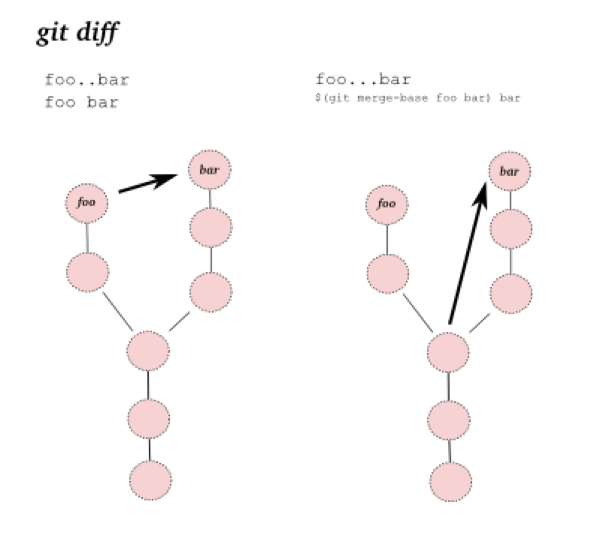
Diff (revisited)
$ git diff A..B
Shows the difference between the tips of two branches.
$ git diff A...B
Shows the difference from their common ancestor

Slide 64
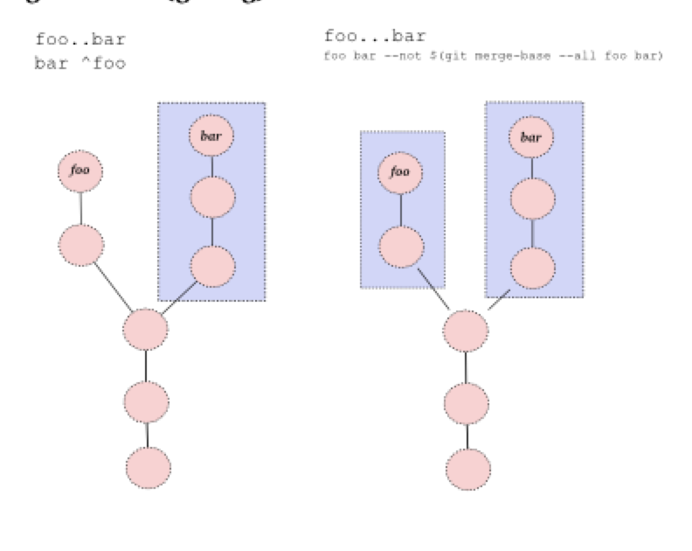
Log (revisited)
$ git log foo..bar
Commits in experiment that are yet to be merged with master. [or Commits that are reachable from experiment but not from master]
$ git diff foo...bar
All the commits that are reachable by either of two references but not by both of them

Slide 65
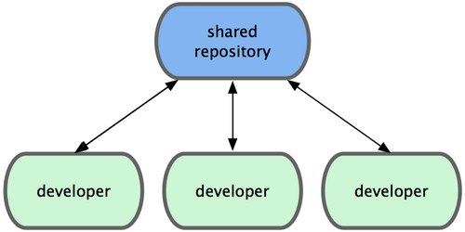
GIT Workflows
Centralized Workflow

Slide 66
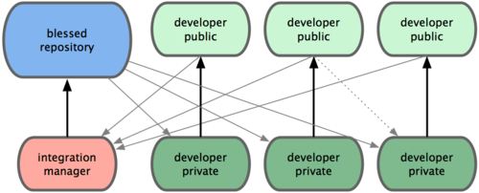
GIT Workflows
Integration manager
Notes:
The project maintainer pushes to their public repository.
A contributor clones that repository and makes changes.
The contributor pushes to their own public copy.
The contributor sends the maintainer an email asking them to pull changes.
The maintainer adds the contributor’s repo as a remote and merges locally.
The maintainer pushes merged changes to the main repository.

Slide 67
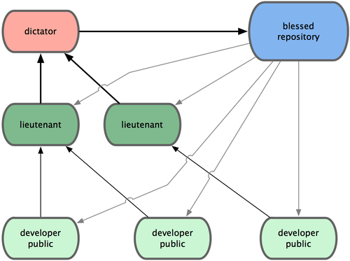
GIT Workflows
Benevolent Dictator
Notes:
Regular developers work on their topic branch and rebase their work on top of master. The master branch is that of the dictator.
Lieutenants merge the developers’ topic branches into their master branch.
The dictator merges the lieutenants’ master branches into the dictator’s master branch.
The dictator pushes their master to the reference repository so the other developers can rebase on it.
It allows the project leader (the dictator) to delegate much of the work, used in linux kernel.

Slide 68
GIT Lab
1. Managing your profile
2. Creating a project
3. Managing Members
4. Code Reviews & Comments
5. Managing Issues + Milestones
6. Cool Commit Messages
7. Merge Requests

Slide 69
Questions
Few References [Recommended Learning]:
http://git-scm.com/doc
https://github.com/pluralsight/git-internals-pdf/releases
Few Interactive Learning [Will get you going]:
https://try.github.io/levels/1/challenges/1
http://pcottle.github.io/learnGitBranching/

Slide 70
GIT Objects
1. Blob
2. Tree
3. Commit
4. Tag
*3 in italics are important to understand git

Slide 71
GIT Objects
1. The Git Directory serves as the Git Object Database.
2. Each object is compressed and referenced by SHA-1 value of [Header + Content].

Slide 72
GIT Objects
tamil@dv-lp-tamil-s:~/gitdemo$ git init Initialized empty Git repository in /home/tamil/gitdemo/.git/ tamil@dv-lp-tamil-s:~/gitdemo$ cd .git/ tamil@dv-lp-tamil-s:~/gitdemo/.git$ ll total 40 drwxr-xr-x 7 tamil tamil 4096 Mar 24 17:25 ./ drwxr-xr-x 3 tamil tamil 4096 Mar 24 17:25 ../ drwxr-xr-x 2 tamil tamil 4096 Mar 24 17:25 branches/ -rw-r--r-- 1 tamil tamil 92 Mar 24 17:25 config -rw-r--r-- 1 tamil tamil 73 Mar 24 17:25 description -rw-r--r-- 1 tamil tamil 23 Mar 24 17:25 HEAD drwxr-xr-x 2 tamil tamil 4096 Mar 24 17:25 hooks/ drwxr-xr-x 2 tamil tamil 4096 Mar 24 17:25 info/ drwxr-xr-x 4 tamil tamil 4096 Mar 24 17:25 objects/ drwxr-xr-x 4 tamil tamil 4096 Mar 24 17:25 refs/

Slide 73
GIT Objects [blob]
1. Stores Contents of files.
2. No file metadata.
3. Two different files with similar contents are marked one [even while transfers].

Slide 74
GIT Objects [tree]
1. List of trees and blobs [similar to ls -l in unix] + Some Header.
2. An entry in tree has mode, type, name and sha of file or another tree.

Slide 75
GIT Objects [commit]
1. Holds a reference to a tree object.
2. Has author, committer, message and any parent commits that directly preceded it.
3. History is built from the references to parent commits.

Slide 76
GIT Objects [tag]
1. Refers to one particular commit object.
2. Has object, type, tag, tagger and a message.
3. Mostly the type is commit and object referred is the SHA-1 of commit being tagged.

Slide 77
GIT Data Model (revisited)
HEAD
branch
remote
commit
tag
tree
blob
Notes:
Explain a bit of how git stores its data

Slide 78
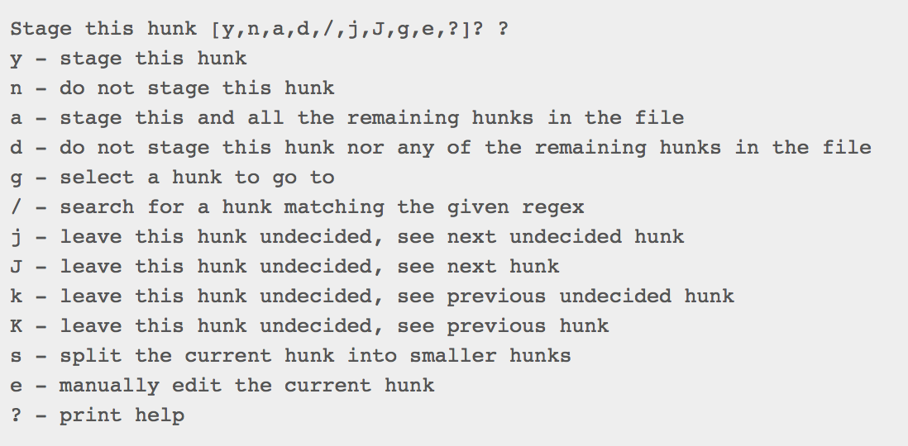
Interactive staging
Only stage certain parts of files and not the rest.
$ git status
$ git add -p
$ git status

